Slide 1
Texts. Assignments. Delivery: Diversifying your Syllabus
Martina P. McGhee, Ph.D.
November 10, 2021

Slide 2
Do you have what you need?
Syllabi/Course Calendar
Checklist
Pen/Highlighter

Slide 3
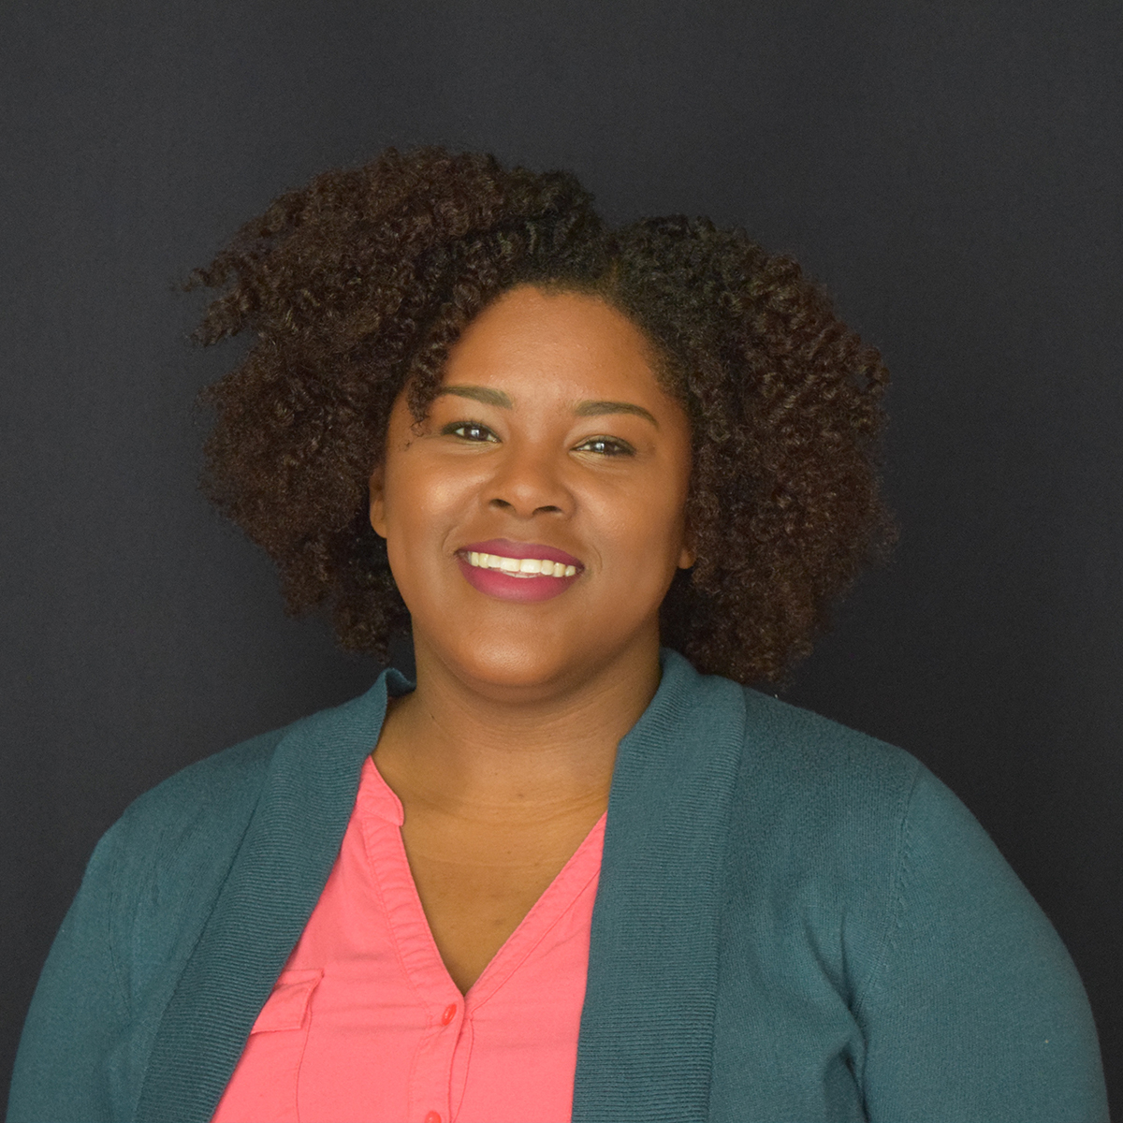
Hello!
I am Martina P. McGhee
I am in Curriculum & Teaching
I teach in the Elementary Ed program

Slide 4
Introduction
She/her
Elementary Ed
Texas
Black Feminist Thought
Bachelor Nation

Slide 5
FOCUS QUESTION:
If we as educators are committed to inclusive excellence, how does that manifest in our courses, curriculum and pedagogy?

Slide 6
Grounding
GOAL 4: Promote diversity and inclusive excellence
Recruit, support, and retain faculty, staff, and students from diverse backgrounds
Enhance diversity and inclusion through impactful leadership, professional service, and engagement
Promote and foster a culture that exemplifies inclusive excellence
Develop and enhance curriculum and training focused on diversity and inclusion for the college and broader communities

Slide 7
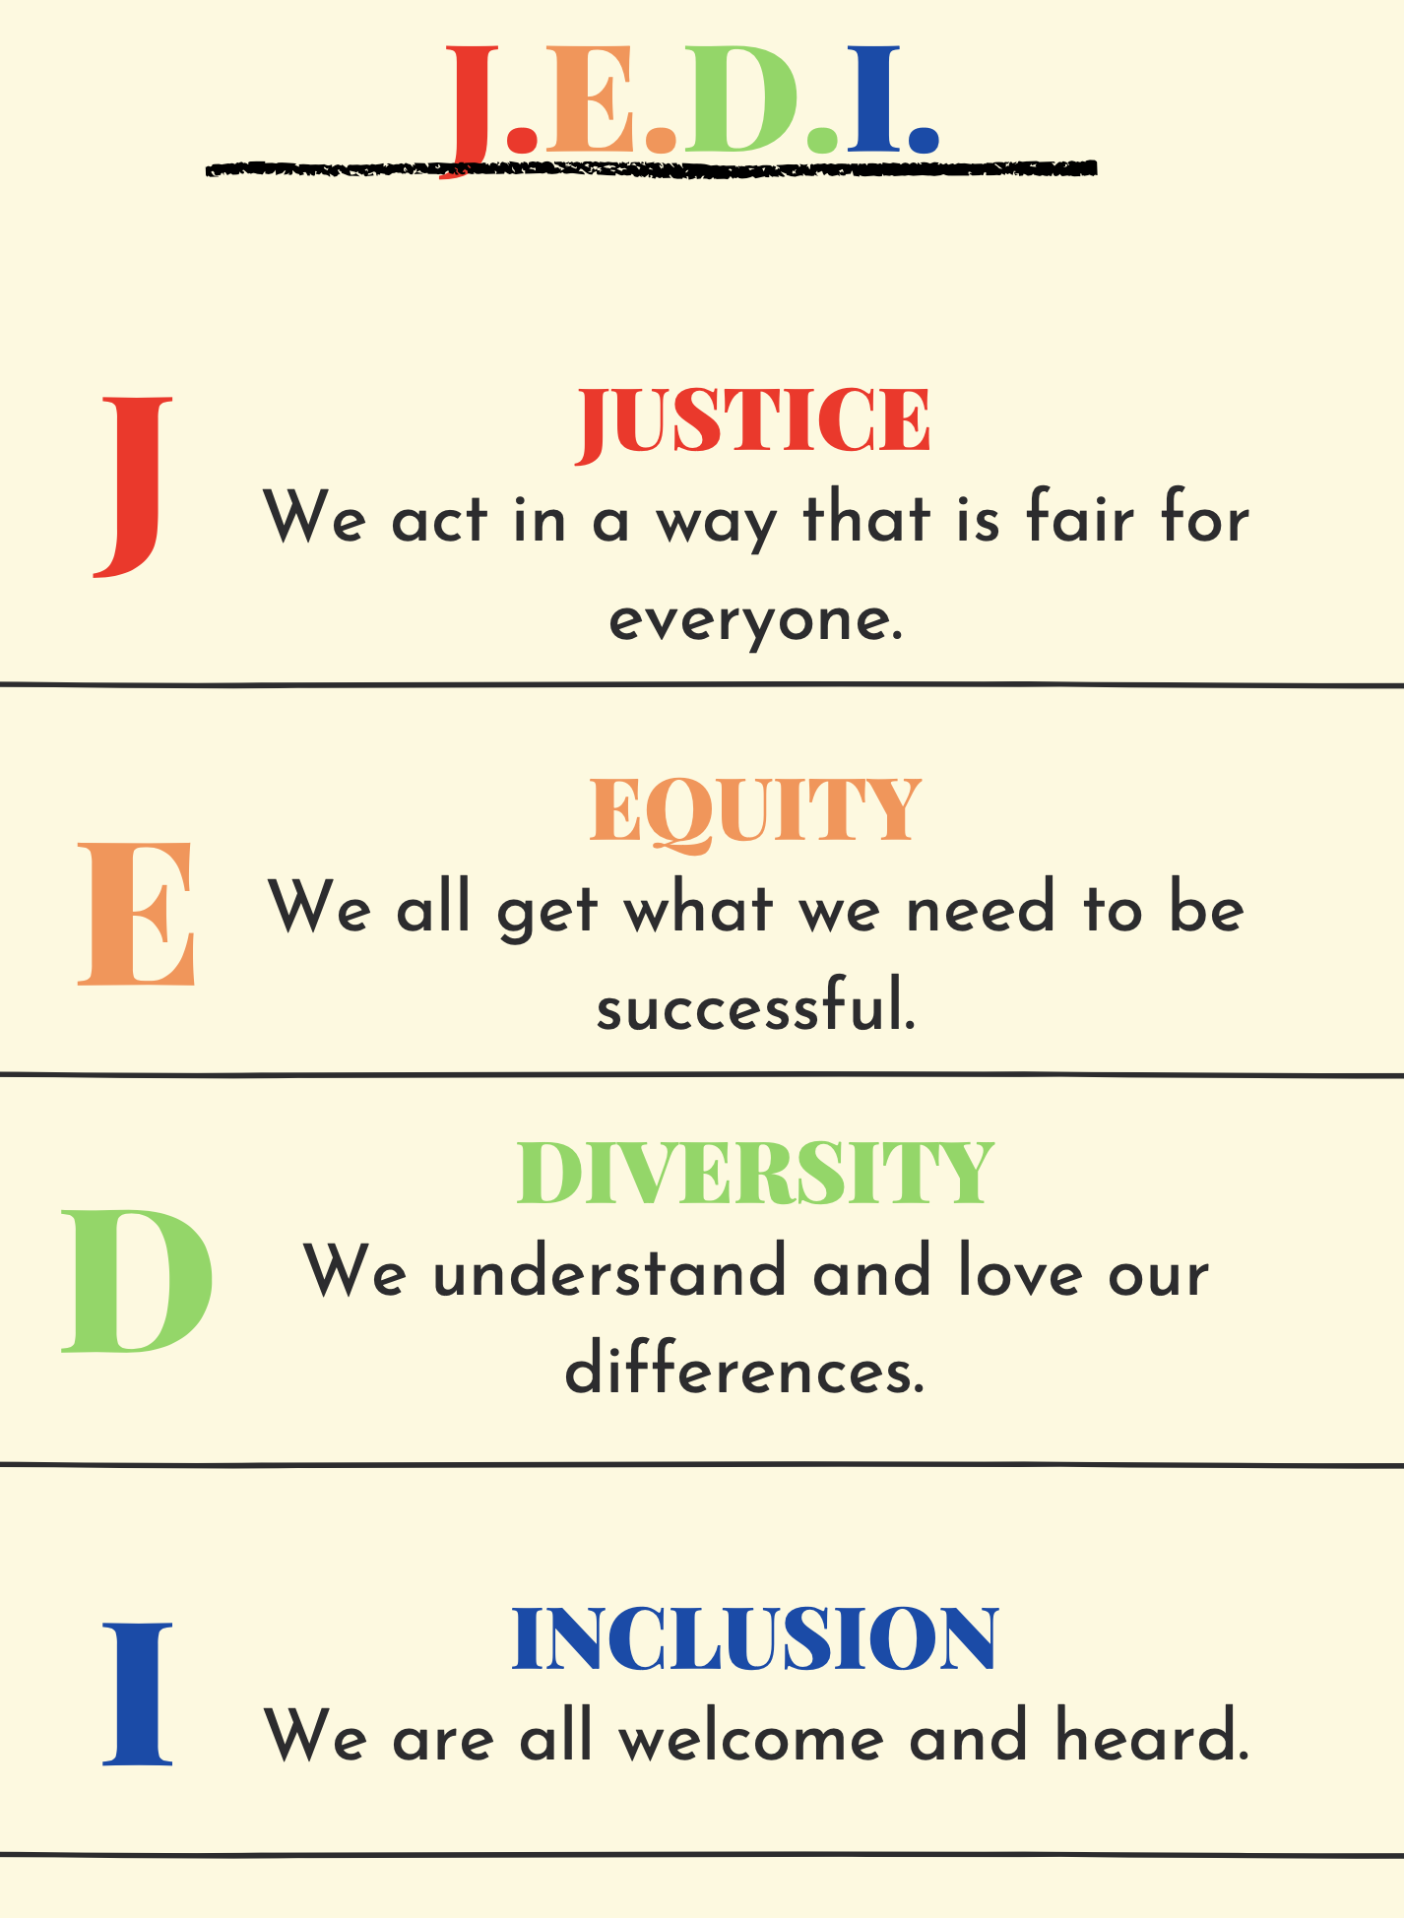
Grounding
Curriculum
What knowledge is worthy? Whose knowledge is worthy?
What is being taught?
Who is being centered?
Pedagogy
How are you teaching?
How are learners positioned in the learning?
J. E. D. I.

Slide 8
What are the underlying assumptions of what you teach?

Slide 9
What are the underlying assumptions of how you teach?

Slide 10
Curriculum Audit: Syllabi Checklist
Text Modalities
Text Authors
Types of Assignments
Instruction Delivery
Syllabi Checklist
Text Authors
Text Modalities
Types of Assignments
Instruction Delivery

Slide 11
Text Modalities.
What different types of texts are used in your course?
What is text?

Slide 12
Text Modalities.
 | Yes | Maybe | No
Texts Modalities
One or more texts is a textbook or academic journal
One or more texts is a video
One or more texts is a novel
One or more texts is a podcast/audio clip.

Slide 13
Authors
Whose voices are included to help your learners make meaning?

Slide 14
Authors
 | Yes | Maybe | No
Texts Authors
One or more authors is a woman.
One or more authors identifies as racially/ethnically marginalized.
One or more authors identifies as part of the LGBTQ+ Community.
One or more authors provides an international perspective.

Slide 15
Assignments.
How are you taking snapshots of what students know or have learned?

Slide 16
Assignments.
 | Yes | Maybe | No
Texts Authors
One or more assignments is required to use APA formatting.
One or more assignments is recursive.
One or more assignments requires modeling or a demonstration.
One or more assignments uses multimodal products.

Slide 17
Instructional Delivery.
How are you teaching during the instructional period?

Slide 18
Instructional Delivery.
How are you teaching during the instructional period?
Lecture
Small Group
Cooperative Grouping
Independent

Slide 19
Instructional Delivery.
How are you teaching during the instructional period?
Lecture
Small Group
Cooperative Grouping
Independent
Lecture: Periods of time where the instructor is providing direct content with limited/no interaction from students.

Slide 20
Instructional Delivery.
How are you teaching during the instructional period?
Lecture
Small Group
Cooperative Grouping
Independent
Small Group Guided Instruction: Working with a group of no more than 6 students.

Slide 21
Instructional Delivery.
How are you teaching during the instructional period?
Lecture
Small Group
Cooperative Grouping
Independent
Cooperative Group: Students working on a specific task or assignment without teacher support.

Slide 22
Instructional Delivery.
How are you teaching during the instructional period?
Lecture
Small Group
Cooperative Grouping
Independent
Independent work time: Students working individually on an assignment or tasks.

Slide 23
Instructional Delivery.
 | Yes | Maybe | No
Texts Authors
I utilize lecture as a means of instruction.
I utilize small group guided instruction.
I utilize cooperative grouping.
I utilize independent work time.

Slide 24
Next Steps
What questions do you have?
What? How? Why?

Slide 25
Thanks!
Any questions? You can find me at:
@martinapmcghee
mpm0060@auburn.edu
Martinapmcghee.com

